Slide 1
Copper / Gold Ratio: Can it predict a market downturn?
What is the Copper Gold Ratio? Price of copper / Price of gold
Why is it used? Copper is used mostly for industrial consumption and gold commonly as a store of value & in jewelry. Thus the price of copper tends to be more sensitive to business cycle pressures.
Relevant Data highlights:
Source: Quandl.com
Pricing used: CME-S&P 500 spot month futures, CME- Gold spot month futures, & CME-Copper spot month futures.
Settle prices for futures were used as well as daily change (“return”) of settle prices.
Correlation of Gold and Copper prices: +.88 The prices of these commodities typically behave similarly.

Slide 2
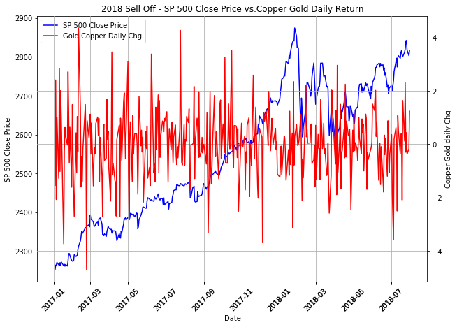
2018 S&P % : Peak to trough return = -19.8%
S&P had steep decline in 1st Quarter of 2018.
Daily % change of Copper Gold Ratio hit “high” highs (~4%) as the S&P climbed.
Daily % change of Copper Gold Ratio hit “lower” lows (~3.5%to 4%) prior to S&P declining.
Daily Change % of Copper Gold ratio appears to be predictive of S&P price directionality.
A false sell-off signal is shown in small pink circle.

Slide 3
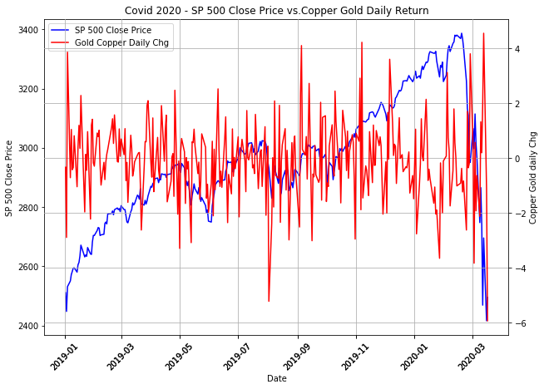
S&P % Peak to trough (this chart) return = -29%
Daily % change of Copper Gold Ratio hit “high” highs (~4%) in Sept, Nov, & Dec 2019 as the S&P climbed.
Daily % change of Copper Gold Ratio hit “lower” lows (3.5%to 4%) prior to S&P declining in 1st quarter 2020.

Slide 4
Copper Gold Ratio Conclusion
The Copper Gold Ratio appears to be a leading indicator of the S&P 500’s performance based on the analysis done here.
More analysis needs to be done to research the reasons for false positives that showed up in some of the charts.
More precise measures on the timing of the indicator relative to market performance are also needed.

